Slide 1
Software Engineering :
7 : Revision 1
Professor Imed Bouchrika National School of Artificial Intelligence imed.bouchrika@ensia.edu.dz

Slide 2
Outline :
Group Projects & Dates
Why Software Engineering
Plan-Driven vs Agile Methodologies
Scrum
UML :
Use Case
Activity/State/Sequence
Class Diagram
Frameworks and Libraries:
Bootstrap / tailwind
Laravel / django ..

Slide 3
Group Projects
Aim of the group project :
Is to prepare you for the after-university
At least, you start to build a vision of what I can produce as a product
To go through the difficulties of working collaboratively inside a team.
Why Team :
Because you will never scale your project on your own.

Slide 4
Group Projects
Important Dates
Week 8 | 20 April 2023 | Spring 1 Submission
Week 9 | TP Sessions | Validation/Review/Feedback of Sprint 1
 | 27 April 2023 | UML Class-Diagram of the project
Week 10 | TD Session | Review of the UML Class Diagram
Week 11 | 06 May 2023 | Spring 2 Submission
Week 12 | TP Sessions | Validation/Review/Feedback of Sprint 2
Week 13 | 20 May 2023 | Submission of Final Product
Week 14 | TP Sessions | Evaluation of the Final Product + Presentation

Slide 5
Group Projects
Important Dates
Every Thursday, the team leader needs to assign an Excel file reporting the following activities :
Daily Scrum
Timesheet of every member
Communication Issues

Slide 6
Group Projects
Marking Schema : Group Mark vs Individual Mark
Ideally, all members will be given the same mark
However,
For cases when we observe that members are not contributing equally, there will be penalizing coefficient ( between 0 and 1 ) that will be computed based on :
Number of commits inside GIT + Size of Code + Impact of functionalities implemented
Attendance of Scrum Meetings reported weekly.
Message Logs between the team members.
Individual Questions during the demonstration

Slide 7
Why Software Engineering
What’s Software Engineering :
A discipline that integrates processes, methods and tools for the analysis, design, development, testing and maintenance of computer software products whilst complying with the set of conventional principles and best practices.

Slide 8
Why Software Engineering
To produce a professional software product within a budget and ontime + meeting the quality requirements :
Usability,
Scalability
Maintainability
Reliability
Openness
…

Slide 9
Why Software Engineering
Main reasons of failures:
Increasing System Complexity :
Systems become larger with increased complexity
The demands and requirements change and increase dramatically
Failure to use Software Engineering Methods
It is easy to write the hello world program without the principles of software engineering. But within a budget can you : maintain it, evolve it and scale it ?

Slide 10
Why Software Engineering
Main reasons of failures:
Bad Management and Poor Leadership
Misuse of the resources / Budget
Lack of communication
Lack of motivation among the employees
Poor Planning
Incorrect Estimation of Budget
…

Slide 11
Why Software Engineering
Why the process or software development cannot be done by a single programmer / individual ?
Why I am assigned to teams who :
Don’t sincerely collaborate on the project
They ignore my messages
Focus on other tasks ( Other modules, lifestyle …)

Slide 12
Software Development Life Cycle
To develop a Software for the “Hello World”
Understand the problem
Perform some design and planning
Code and Develop the Software
Validate and test the software
Release, Install, Run or Deploy the software for the client
Maintenance and Support

Slide 13
Software Development Life Cycle
To develop a Software for the “Hello World”
Requirement Analysis : Understand the problem
Design : Perform some design and planning
Implementation : Code and Develop the Software
Testing : Validate and test the software
Integration : Release, Install, Run or Deploy the software for the client
Maintenance : Maintenance and Support

Slide 14
Software Development Life Cycle
Design and Planning
Implementation & Development
Requirement Engineering
Maintenance
Testing

Slide 15
Software Process and Activities
Process :
is a collection of activities, actions, and tasks that are performed during the development life cycle of the software product including the maintenance phase.
The process is composed of activities which
Can be decomposed into actions or deliverables which
are composed of tasks

Slide 16
Software Process and Activities
Process Activities :
Generic Activities in a Software Engineering Process:
Requirements Specification
Design and Planning
Coding/Implementation/Construction
Testing
Integration
Maintenance

Slide 17
Software Process and Activities
Process Activities : The following information needs to be defined :
Deliverable : The outcome of the activity, for example:
Architectural Design
Specification Documentation
Role : Reflects the responsibilities of the people involved in the activity
Condition ( Pre- or Post- ) : Statements or conditions before or after the activity. For example, the design Activity :
Pre-condition : Specification Requirements Activity must be completed
Post-condition : Architectural Designs must be reviewed by an Expert.

Slide 18
Software Process Models
What’s a Process Model :
is a description of what activities/tasks need to be performed in what sequence under what conditions by whom to achieve the desired results
is an abstract representation of how a process is conducted in terms of structuring and ordering the tasks to develop the software product
The model describe the process flow

Slide 19
Software Process Models
What’s a Process Model :
It can be linear workflow
Activity 1
Activity 2
Activity 3
Activity 4

Slide 20
Software Process Models
What’s a Process Model :
Or iterative/cyclic workflow
Activity 1
Activity 2
Activity 4
Activity 3

Slide 21
Software Process Models
What’s a Process Model :
Or even parallel workflows
Activity 1
Activity 2
Activity 3
Activity 4
Activity 1’
Activity 2’
Activity 3’
Activity 4’
Combine
Activity 1’’
Activity 2’’
Activity 3’’
Activity 4’’

Slide 22
Software Process Models
Types of Process Models
Plan-Driven Processes :
are processes where all of the process activities are planned in advance and progress is measured against this plan

Slide 23
Software Process Models
Types of Process Models
Agile Processes :
Planning is incremental and it is easier to change the process to reflect changing customer requirements.

Slide 24
Software Process Models: Traditional Methodologies
Requirement Analysis
Waterfall Model :
Design and Planning
Implementation
Testing
Integration
Maintenance

Slide 25
Software Process Models: Traditional Methodologies
Waterfall Model :
Strength :
Works for well-understood problems
Forces the software team to complete requirements before design, design before code…
It is easy to manage due to the rigidity of the model – each phase has specific deliverables and a review process.
It can protect the company from the risk of diving into never ending requirements and changes.

Slide 26
Software Process Models: Traditional Methodologies
Waterfall Model :
When to use it :
Embedded systems : Because of the inflexibility of hardware, The software’s functionality must be therefore specified clearly to accommodate the hardware without the unpredictability to change.
Critical systems where there is a need for extensive safety and security analysis of the software specification and design. Safety-related problems in the specification and design are usually very expensive to correct at the implementation stage.
Large software systems that are part of broader engineering systems developed by several partner companies.

Slide 27
Software Process Models: Traditional Methodologies
Incremental Process Model:
Requirement Engineering
Requirement Analysis for Part A
Design and Planning for A
Requirement Analysis for Part B
Design and Planning for B
Implementation of A
Requirement Analysis for Part C
Test Build A
Maintenance
Implementation of B
Design and Planning for C
Integration A
Test Build B
Implementation of C
Integration B
Full System
Test Build C
Integration C

Slide 28
Software Process Models: Traditional Methodologies
Incremental Process Model:
Requirements of the Full Software are first broken down into several modules/Subsystems/Set of Functionalities that can be incrementally constructed and delivered consecutively
Initially : The Development Team ensures the development of core features of the system as the first release.
Once the core features are fully developed, then new modules/functionalities are added in Successive versions.
Each incremental version is usually developed using an iterative waterfall model of development.

Slide 29
Software Process Models: Traditional Methodologies
Maintenance
Integration
Prototyping Process Model:
Build Prototype
Testing
Requirement Analysis
Quick Design
Prototype Evaluation
Implementation
Review and Update

Slide 30
Software Process Models: Traditional Methodologies
No Code Process Model:
Aims to develop software products using “Drag and Drop” Platforms offering pre-built components to conduct various types of business logic.
Existing Tools/Platforms :
Bubble
Visual Programming Languages
With or Against ?
Scalability ?
Custom Business Logic ?
Sovereignty ?

Slide 31
Software Process Models: Agile Methodologies
What’s Agile
Agile processes are a family of software development methodologies that produce software in short iterations and allow for greater changes in design.
Although there is no absolute definition about what constitutes an Agile method, there are several characteristics shared by most Agile methods
The philosophy behind agile methods is reflected in the agile manifesto ( http://agilemanifesto.org) issued by the leading developers of these methods

Slide 32
Software Process Models: Agile Methodologies
Agile Manifesto:
We are uncovering better ways of developing software by doing it and helping others do it. Through this work we have come to value:
Individuals and interactions over processes and tools
Working software over comprehensive documentation
Customer collaboration over contract negotiation
Responding to change over following a plan
That is, while there is value in the items on the right, we value the items on the left more

Slide 33
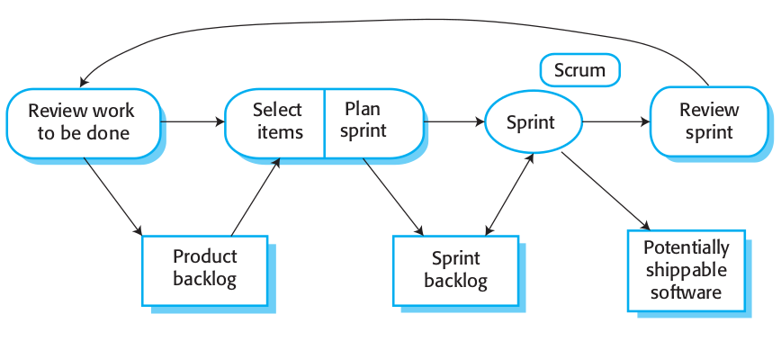
Scrum Principles for Software Projects
Scrum Process Model

Slide 34
Scrum Principles for Software Projects
Scrum : Definition
Is a project management framework or even a methodology composed of a set of principles for creating, improving and delivering high-quality products to customers in an iterative and incremental way.
It emphasizes on teamwork, collaboration, communication, transparency and continual improvement among team members ⇒ ( Self-organized Teams )
Scrum is built upon by the collective intelligence of the people using it. Rather than provide people with detailed instructions, the rules of Scrum guide the relationships and interactions

Slide 35
Scrum Principles for Software Projects
Scrum Roles for Committed members (Scrum Team):
Product Owner
Scrum Master
Development Team

Slide 36
Scrum Principles for Software Projects
Scrum Artifacts :
Product Backlog :
List of all features, functions, requirements, enhancements, and fixes to be made to the product in future releases.
Product Backlog items :
Have the attributes of a description, order, estimate duration and value.
Include test descriptions that will prove its completeness when "Done".
Product Backlog refinement is the act of breaking down and further defining Product Backlog items into smaller more precise items
Maintained and managed by the Product Owner.

Slide 37
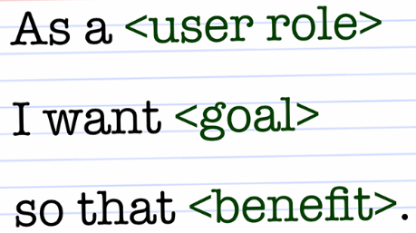
Scrum Principles for Software Projects
Scrum Artifacts :
Product Backlog :
Items are usually inserted in the form of
User Story : is an informal statement to express a small feature from the perspective of an end-user whilst clearly showing the value.
As a (Website Visitor), I want to (login) , so that I can (access my expenses)
As a (Website Visitor), I want to (reset password) , so that I can (regain access to my account)
Action Task : Corresponding to an action item to be executed.
Implement UI for login with minimal design.
Implement BL to verify authentication against internal DB
Epic : Set of stories that would correspond to a major feature/component to be implemented.
Internal Dashboard to add expenses.

Slide 38
Scrum Principles for Software Projects
Scrum Ceremonies ( Events ) :
Are meetings or events to inspect and adapt Scrum artifacts with the aim to improve transparency.
To reduce complexity, Scrum events are held at the same time and same place.
List of Scrum Events
Sprint Planning
Daily Scrum
Sprint Review
Sprint Retrospective

Slide 39
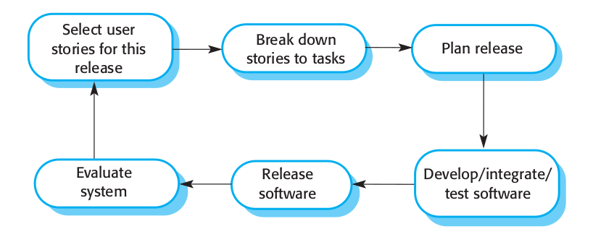
eXtreme Programming (XP)
XP Process Model

Slide 40
eXtreme Programming (XP)
eXtreme Programming (XP) Principles:
Code Standard
Refactoring
Pair Programming
Test-Driven Development
Collective Code Ownership
Continuous Integration
Small Release
Onsite Customer
Sustainable Pace
System Metaphor
Simple Design
Planning Game

Slide 41
Requirements Engineering
Requirements Engineering : Definition
It is a systematic process of developing the requirements through an iterative way of discovering, documenting and managing a set of requirements for a software system in addition to the constraints under which it operates.

Slide 42
Requirements Engineering
Objectives of Requirements Engineering
To decide precisely what to build and document the results.
To produce a set of system/software requirements that, as far as possible, is complete, consistent, relevant and reflects what the customer actually want

Slide 43
Requirements Engineering Process
Requirements Engineering Process :
Requirements Elicitation
Requirements Analysis
Requirements Documentation
Validation

Slide 44
Requirements Engineering Process
Activity 1 : Requirements Elicitation
Problems with the Elicitation of Requirements :
Stakeholders don’t know what they want
Stakeholders express requirements in their own terms (vs. language of coders)
Stakeholders are unconvinced of the need for a new system
Different stakeholders may have conflicting requirements
Stakeholders may give unnecessary information
Organisational and political factors may influence the system requirements.
The requirements change during the analysis process.
New stakeholders may emerge and the business environment may change.

Slide 45
Modeling and Design
Software Design :
It is a creative process to transform users requirements into visualized form to describe what and how the system will be developed.
a transition from "what" the system must do, to "how" the system will do it
The aim is to produce an implementable solution to a problem.
An iterative process through which a customer’s requirements are translated into a blueprint for constructing the software code.
All design work products must be traceable to the software requirements document (SRS)

